Slide 1

Swiggy End-to-End Data Analytics & Churn Prediction
This presentation documents an end-to-end analytics project built on a multi-table Swiggy-style food-delivery dataset. The pipeline spans SQL extraction, Power BI dashboards, Python exploratory analysis and feature engineering, machine learning churn modeling, and production deployment using Flask, Docker, and Render. Intended audience: product managers, data science leads, and analytics stakeholders at consumer tech or food-delivery companies.

Slide 2

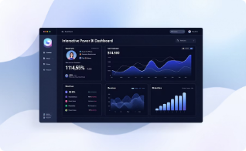

Executive Summary
This project builds a production-ready churn prediction capability and accompanying analytics layer to support retention and revenue-growth decisions. Key objectives: understand revenue behavior, segment customers, quantify churn drivers, predict attrition at the user-level, and deliver an interactive dashboard plus a deployable prediction API. Technologies: SQL for extraction & aggregation, Power BI for KPI visualization, Python for EDA and modeling, ML algorithms for churn prediction, and Flask + Docker + Render for cloud deployment.
Data Layer
Analytics Layer
ML & Deployment
Multi-table joins (users, orders, restaurants, menu, food) producing a consolidated event-level dataset (~1.18M rows).
Power BI dashboards for revenue trend, city performance, and cohort analysis enabling stakeholder self-serve exploration.
Feature engineering, model training (classification), evaluation, and deployment as an API using Flask containerized with Docker and hosted on Render.

Slide 3


Business Problem Statement
Swiggy operates in a highly competitive market with revenue volatility and elevated churn. This analysis answers core strategic questions: Is revenue stable or volatile? Which cities generate sustainable revenue? Do ratings influence sales? Are customers being retained or churning? What share of customers drives most revenue? Can we predict churn early enough to act?
Revenue Stability
Measure trends, volatility (std dev), and seasonal effects to detect risk periods for revenue.
City Performance
Rank cities by revenue, growth, and retention to prioritize investment and ops focus.
Churn Prediction
Predict at-risk users so product and marketing teams can intervene with targeted retention tactics.

Slide 4


Dataset Architecture
The analysis used five core tables: Users, Orders, Restaurants, Menu, and Food. Relationships: Users (1) → Orders (many); Restaurants (1) → Orders (many); Restaurants (1) → Menu (many); Menu (1) → Food (many). After merges and cleaning, the consolidated dataset contains ~1.18M rows of order-level events with user, restaurant, item, city, timestamp, rating, and monetary fields.
Users
Orders
Restaurants & Menu
Demographics, signup date, city, anonymized user_id for longitudinal analysis.
Order timestamps, order value (₹), items ordered, status, and ratings—primary event granularity.
Restaurant metadata, cuisine, menu items and prices used for item-level revenue and cross-sell analysis.

Slide 5

SQL Analysis Layer
SQL powered the extraction and business-logic layer: joining tables to assemble user-level histories, aggregating revenue by time and city, computing frequency and recency, and deriving segmentation buckets. Key SQL outputs fed Power BI and model feature tables—ensuring reproducibility and auditability of metrics.
1. Data Joins & Cleans
2. Aggregations
3. Segments & Labels
Left-joins, deduplication, timezone-normalized timestamps, and missing-value rules to create reliable event data.
Revenue by month, city, customer CLV, frequency, and average order value computed at SQL layer for scale.
Behavioral segments (active, at-risk, churned) and training labels derived using recency and inactivity windows.

Slide 6
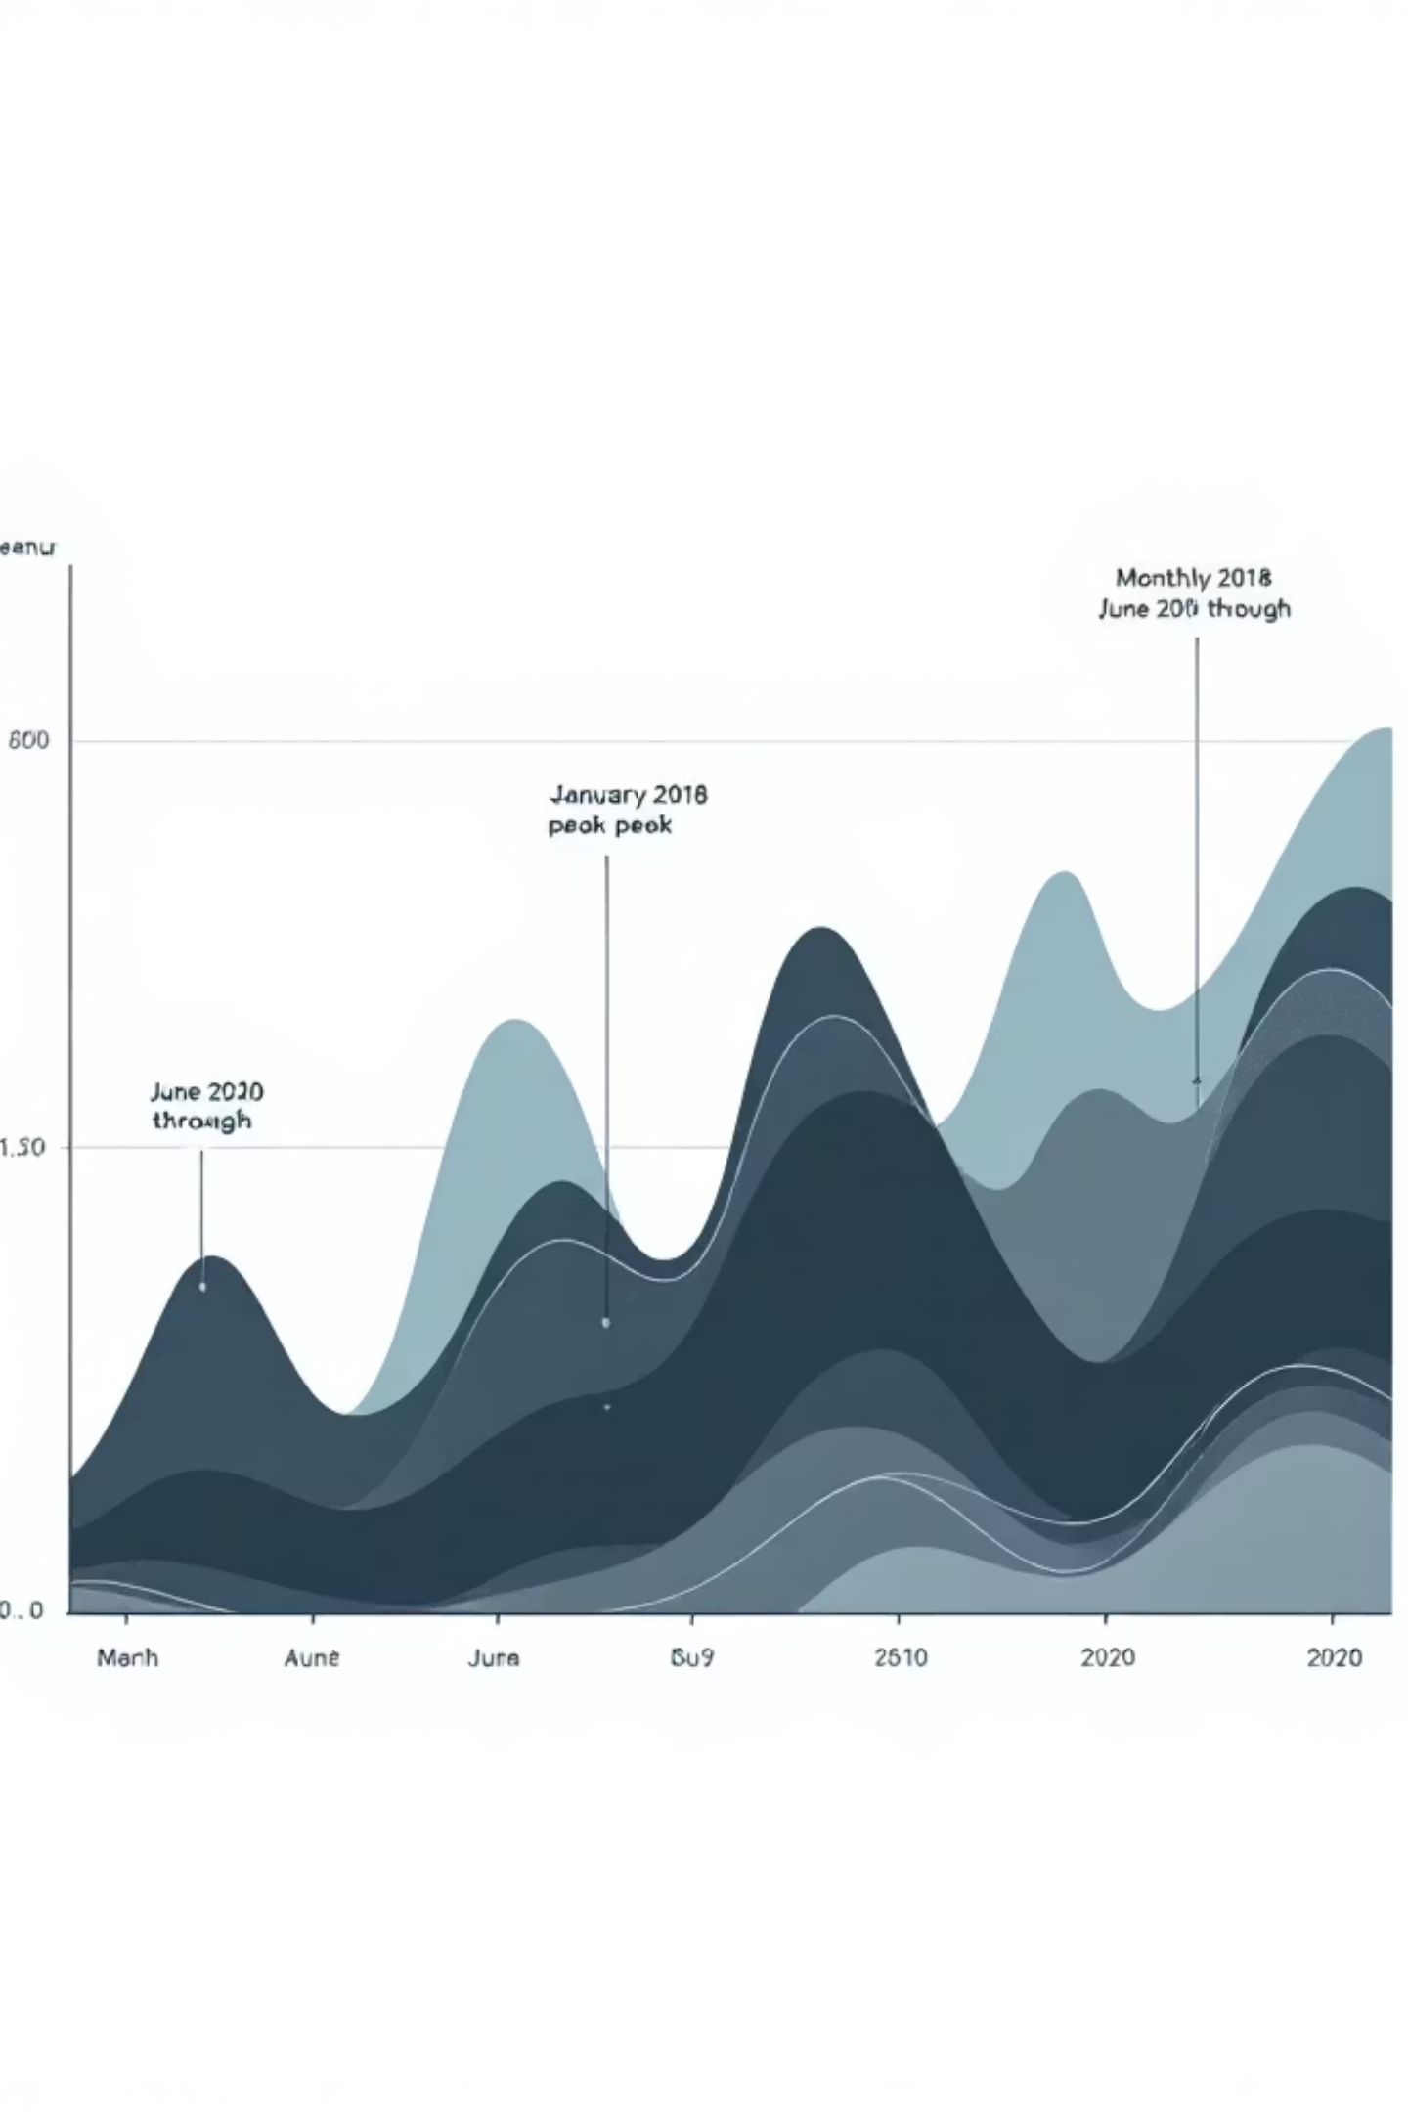
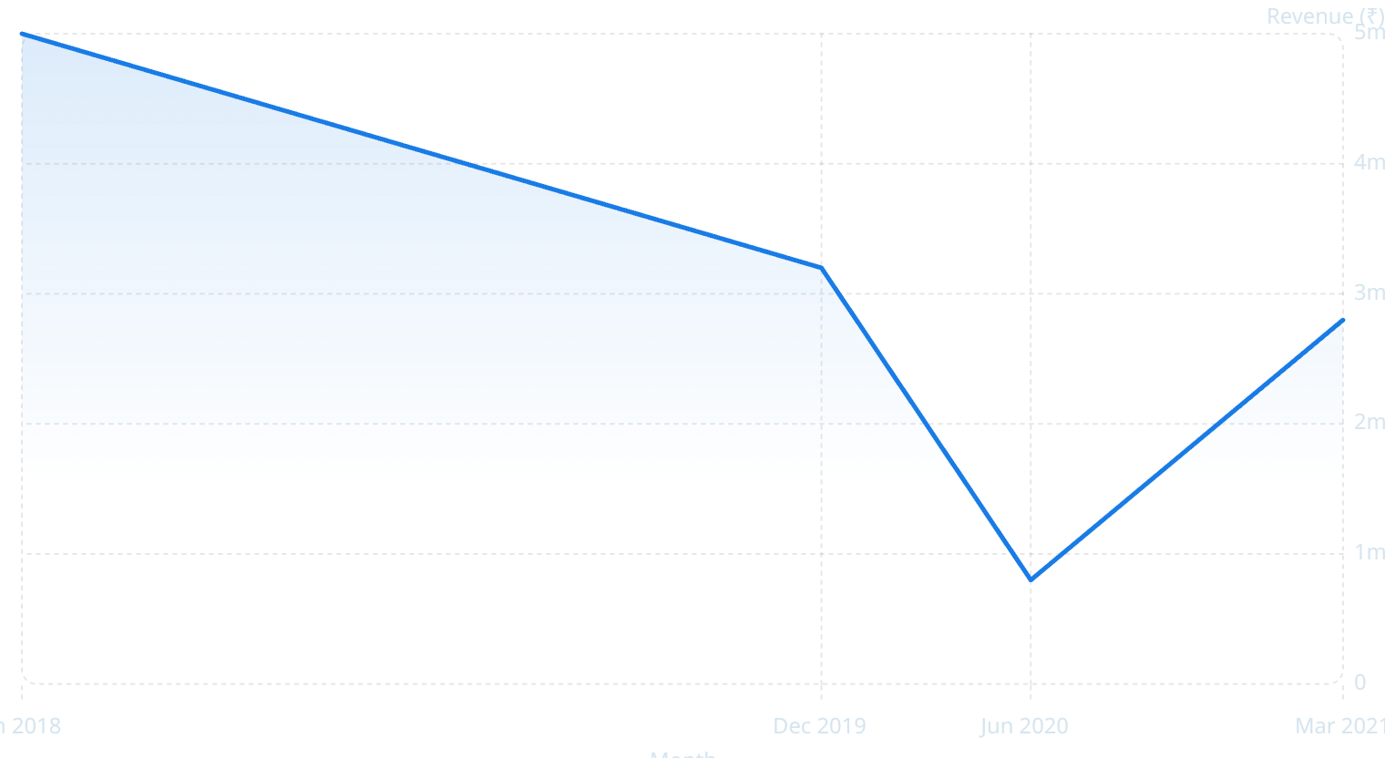
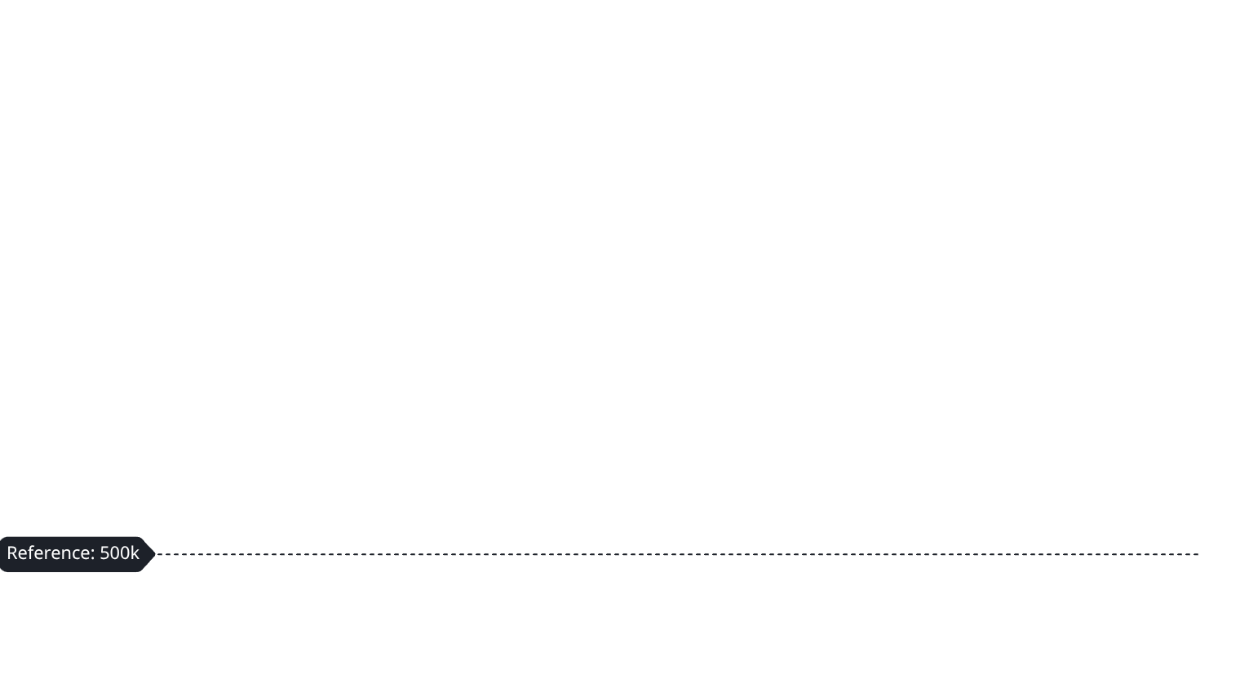
SQL Insights — Monthly Revenue Trend
Revenue displays material month-to-month fluctuation. Observed peak in January 2018 (~₹5 Crore) and trough in June 2020. Volatility metrics: standard deviation ≈ ₹5.38M and coefficient of variation ≈ 18.5%. Practical implication: marketing cadence, promotions, and external events materially affect top-line performance—necessitating responsive operational planning.

Slide 7
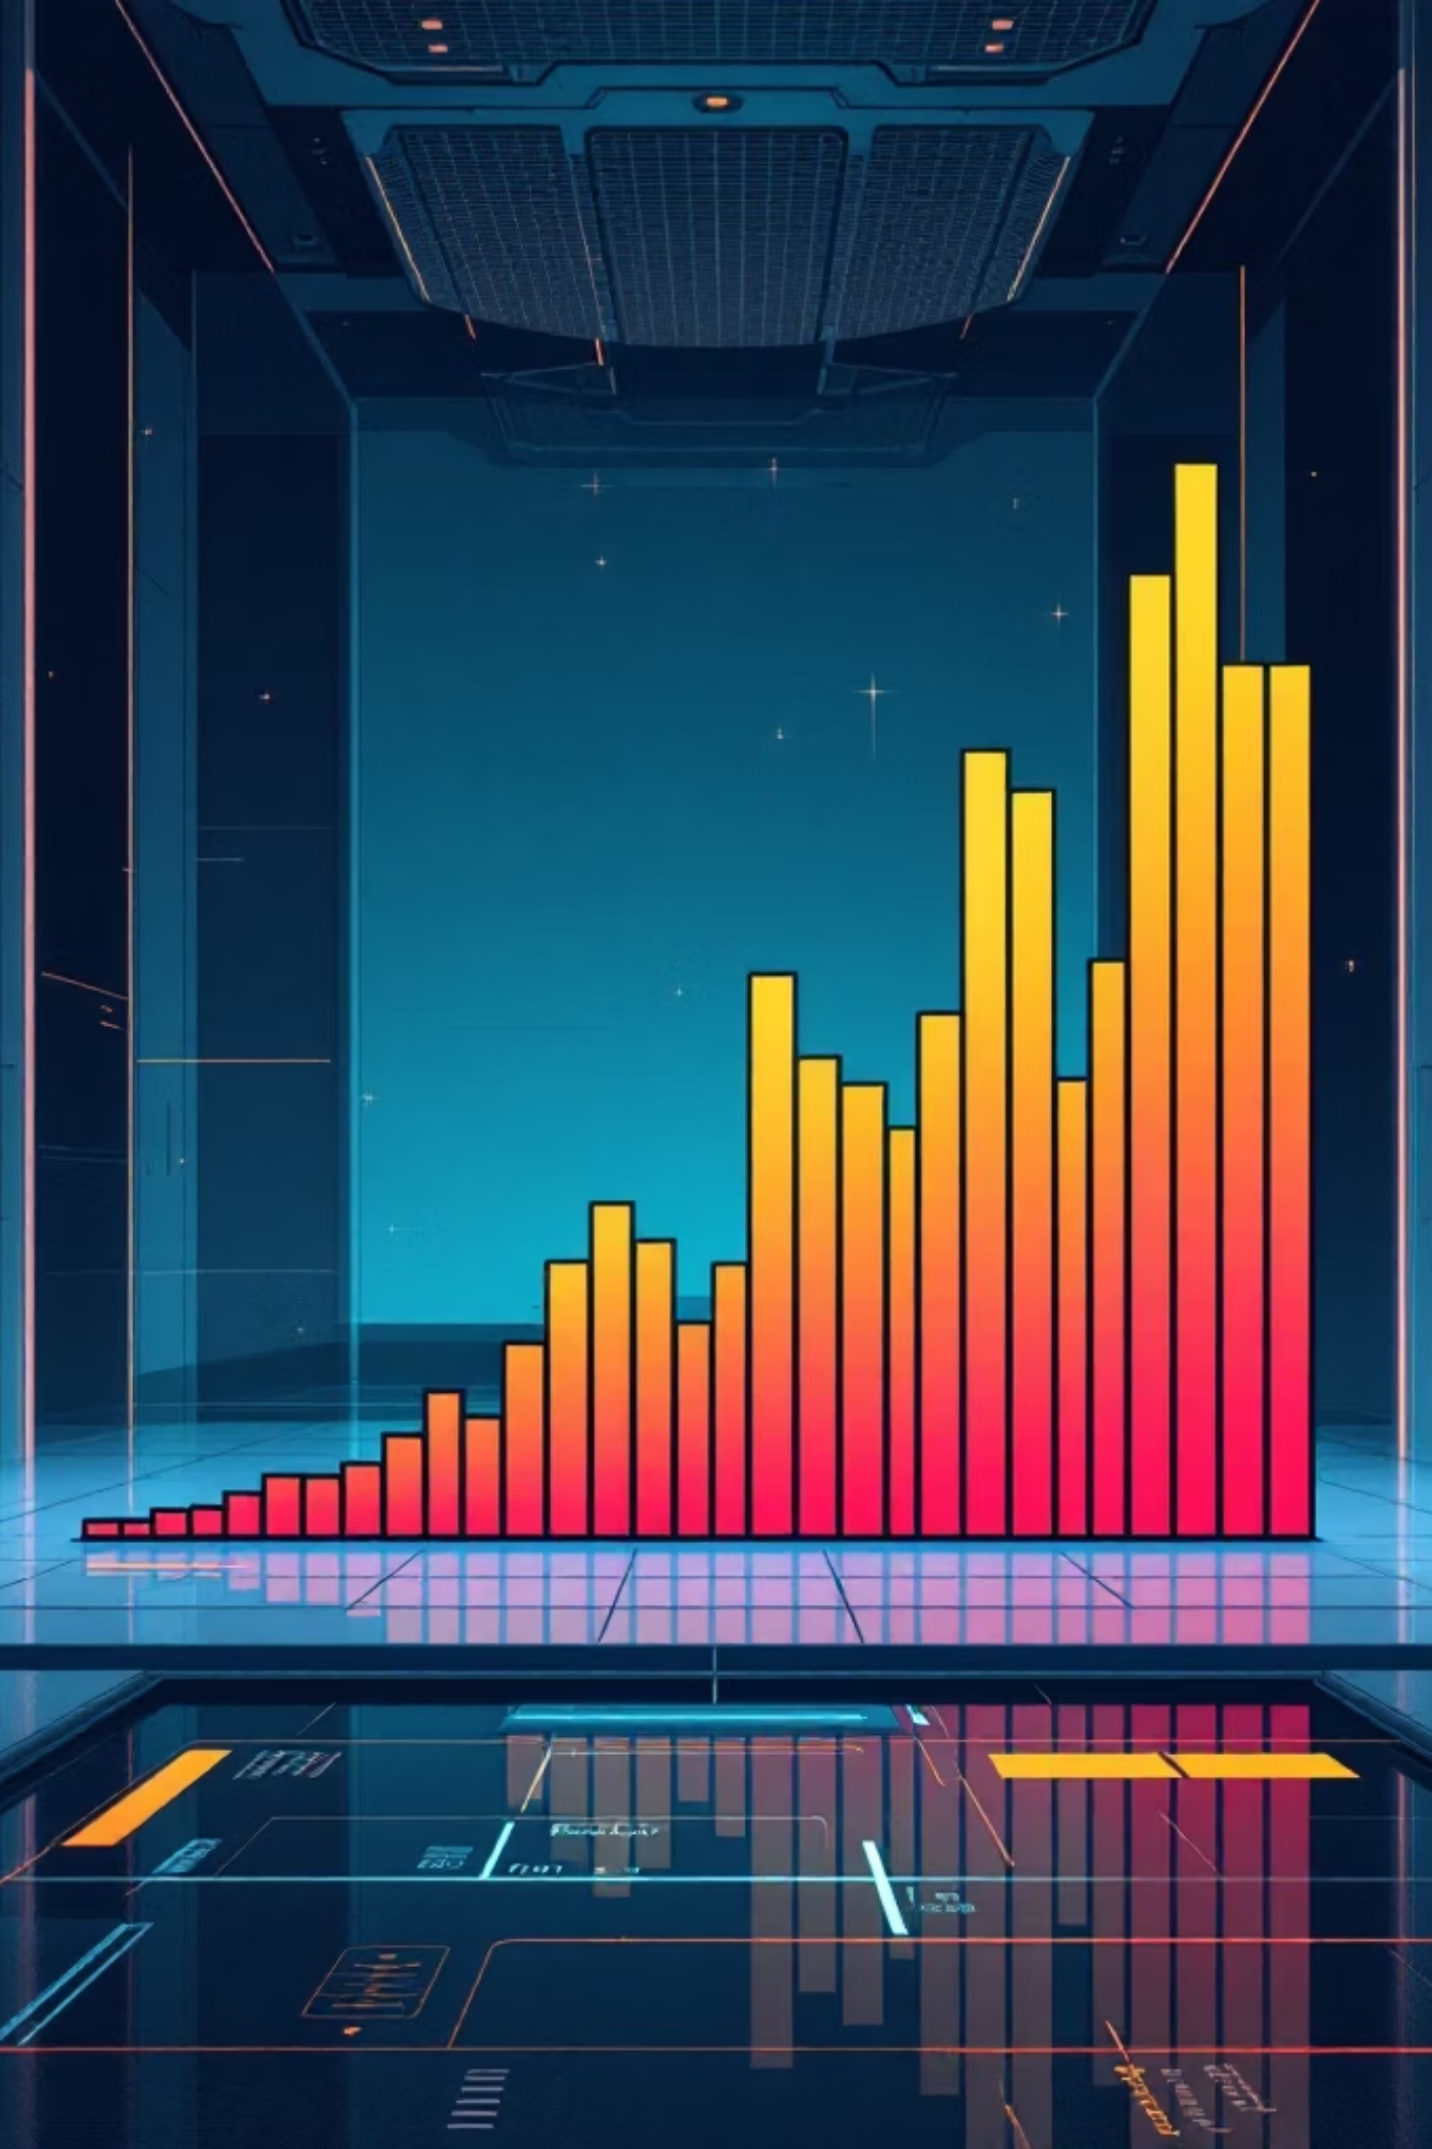
SQL Insights — Revenue Distribution & Risk
Distributional analysis shows extreme skew: skewness ≈ 18.36 and kurtosis ≈ 569.97. A small number of very large orders and high-value customers dominate total revenue. Business risk: losing a few high-value customers or accounts could lead to outsized revenue decline; retention and bespoke offers for premium customers are high-impact priorities.
Skewness
Kurtosis
Action
18.36 — indicates long right tail with rare, large transactions.
569.97 — extreme peakedness; distribution concentrated at low values with fat tails.
Prioritize VIP retention programs and diversify revenue base through acquisition and geographic expansion.

Slide 8


SQL Insights — City-Level Performance
City segmentation identifies 'Premium' markets (Sirsi, Tirupati, Srikakulam) generating outsized revenue per user and 'Stable' markets (Kovilpatti, Orai, Osmanabad) with consistent volume but lower ARPU. Strategic recommendation: concentrate retention and service reliability investments in premium cities; pursue scaled marketing and supply-side improvements to grow stable cities.
Premium Cities
Stable Cities
High ARPU and sensitivity to service—targeted retention and loyalty yields significant ROI.
Lower ARPU but predictable volume—scale-focused acquisition and logistics optimization recommended.

Slide 9

Customer Lifetime Value & Pareto Effect
Mean CLV = ₹12,484 while Median CLV = ₹1,921. The large gap confirms a classic Pareto distribution: roughly 20% of customers account for ~80% of revenue. Implications: targeting acquisition and retention budgets to high-CLV cohorts improves LTV/CAC, while lower-value cohorts require scalable, low-cost retention tactics.
₹12,484
₹1,921
20%
Mean CLV
Median CLV
Top Cohort
Average lifetime spend across all users (sensitive to high spenders).
Typical customer spend—much lower than mean, revealing skew.
Estimated proportion of users driving ~80% revenue—priority for personalized retention.

Slide 10


Demographics & Feature Engineering — Age vs Spending
Correlation between age and spending is approximately zero, indicating age is not a strong predictor of revenue in this dataset. Modeling implication: deprioritize age as a primary predictive feature; instead focus on behavioral signals (recency, frequency, monetary value, order patterns, ratings, and city-level context) for churn prediction and CLV estimation.
Behavioral Features
Churn Model
Targeted Retention
Next steps: finalize ML feature set emphasizing behavioral signals, iterate model thresholds with business KPIs (LTV uplift per retention action), and deploy a prediction API for in-product targeting and measurement.

Slide 11

Power BI Dashboard Layer
Power BI was instrumental in building an interactive, user-friendly dashboard layer, translating complex SQL analyses and machine learning outputs into actionable business insights. This layer provided real-time visibility into key performance indicators and customer behavior across various dimensions.
Interactive KPI Dashboards
Built to monitor key metrics, providing a holistic view of business performance and health.
Dynamic Slicers
Enabled granular data exploration, allowing users to filter and analyze specific customer segments or timeframes.
Churn Pattern Visualization
Illustrated trends in customer attrition, highlighting periods and cohorts with high churn rates.
Revenue Segmentation
Visualized revenue distribution across different customer segments for targeted strategies.
City Heatmaps
Displayed geographical performance, identifying high-value and at-risk markets at a glance.

Slide 12

Key Behavioral Insights & Churn Analysis
Exploratory Data Analysis revealed critical behavioral patterns impacting customer retention and revenue. Understanding these dynamics is essential for effective churn prediction and targeted intervention strategies.
Order Frequency
Recency vs. Revenue
Active vs. Churned
Mean orders: 2.4, Median: 2. Most customers place only 1-2 orders before becoming inactive.
Correlation: -0.0673. Inactive customers show significantly lower spending patterns.
Active users average 2.42 orders and ₹16,414 revenue, compared to 1.83 orders and ₹11,936 for churned users. This difference is statistically significant (P-value = 0.0).
RFM Segmentation & Strategic Meaning
Champions (~15%)
Loyal (~40%)
Our most valuable, recent, and frequent customers – focus on loyalty programs.
Regular customers with good spend – nurture and encourage upselling.
Potential Loyalists (~28%)
At Risk (~17%)
Newer customers with potential for growth – convert to loyal through engagement.
Customers whose activity is declining – prioritize reactivation campaigns.
🚨 Business Reality: High Churn Rate
With churn defined as 90 days of inactivity, the platform faces an extremely high churn rate of 87.76% (67,778 churned vs. 9,457 active users). This indicates a critical need for targeted retention strategies.

Slide 13
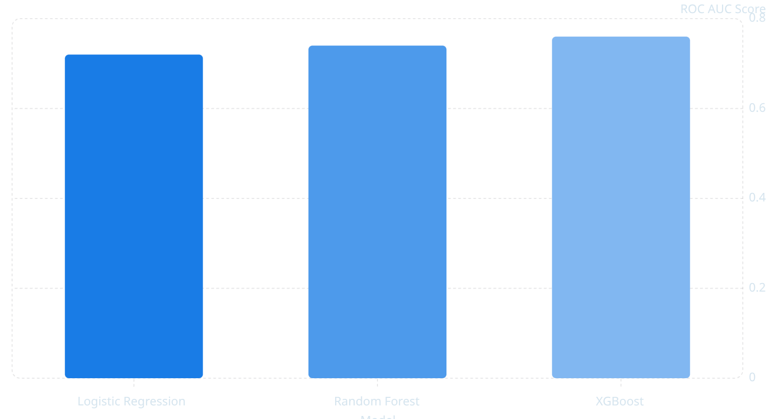
Machine Learning Layer
To build a robust churn prediction system, several machine learning models were tested and evaluated based on their ROC AUC scores. The goal was to identify the most effective algorithm for accurately predicting customer churn.
After initial testing, an optimized Random Forest model achieved a significantly higher ROC AUC of 0.91, making it the chosen model for production deployment.
Key Feature Importance
1
2
Recency
Total Orders
Strongest predictor: how recently a customer made an order.
Cumulative number of orders placed by the customer.
3
4
Avg Order Value
Total Revenue
The average spend per order, indicating customer value.
Overall revenue generated by the customer.

